Slide 1
BioNano Bot Timeline
Team Members:
S. Vineesha
Dhruv Agrawal
Sagar Srivastava
Goyir Koyu

Slide 2
Timeline:
Phase I
Create a basic simulation
Combining the already existing models for the tumor cell and the pso simulation and research the environment for the tumor cell.
Phase III
Designing the NanoBot
Deciding the components of the Nanobot. Finding the simulation tool for designing the bot.
10 - 15 Jan
23 - 25 Dec
20 - 30 Jan*
Phase II
Improving the simulation
Improving upon the basic simulation and defining a metric for comparing different swarming algorithms.
Further to be decided
Approaching professor for guidance. Document the results to create a paper. Get funding to manufacture the bot.

Slide 3
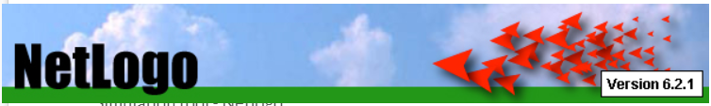
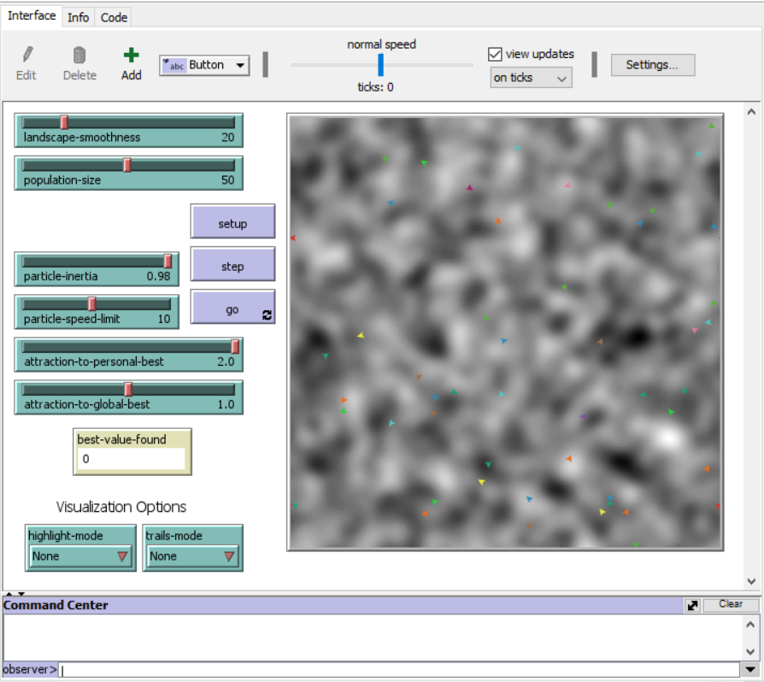
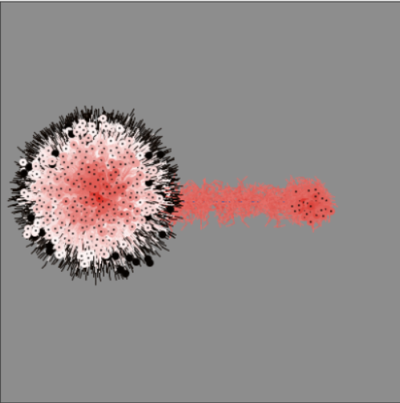
Phase I - Basic Simulation
-Combining both algorithms.
-Optimising PSO algorithm to detect the Tumor.
PSO Algorithm Simulation
Tumor Cell Simulation

Slide 4
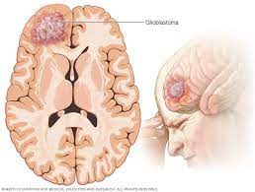
Tumor - Glioblastoma (Brain Cancer)
-Reading different papers to understand the the conditions surrounding the glioblastoma .
-Creating/modifying the simulation which identifies the different surrounding conditions and helps in locating the glioblastoma precisely.
-Continuing the study of Glioblastoma , and studying vascular system.
-Exploring various possibilities for control and movements of bots through the vascular systems .
-Finding optimal route for the Bots to reach glioblastoma from the site of injection . Finding best site for injection
of Bots.

Slide 5
Phase II - Improving the simulation
-Improving upon the basic simulation and defining a metric for comparing different swarming algorithms.
-Simulating the movements of bots in the vascular systems. Combining it with tumor detection/swarming algorithm.
Destroy Cancer cells:
Simulating the methods for termination of the glioblastoma by release of suitable drugs on the site of cancer using quorum sensing
Planning for way back home
Searching for methods to remove the bots from the body

Slide 6
Phase III - Design
Designing the NanoBot
-Deciding the components of the Nanobot. Finding the simulation tool for designing the bot.
-Searching for materials , actuators , sensors for manufacturability.

